Slide 1
Kiddie Tax Other Taxes
Pub 4012 – Tab H
Pub 4491 – Lessons 20 and 27
Notes:
Expanded section on Kiddie Tax – slides 2-14

Slide 2
Tax for Children with Unearned Income – “Kiddie Tax”
Pub 4012 Tab A
Taxpayer (refers to child) has more than $2,100 in unearned income
Taxpayer has a filing requirement
Find Pub 4012 Tab A Chart B For Children and Other Dependents
Taxpayer meets the test for kiddie tax – next slide
Taxpayer’s earned taxable income is taxed at ordinary rates while unearned income is taxed at trust rates
Preferential capital gains rates apply (modified)
Notes:
Encourage class to read notes at the top of Chart B and the bottom section on the kiddie tax

Slide 3
Kiddie Tax Filing Requirements – Must Meet ALL
Taxpayer (child) either:
Under age 18 December 31, 2018 -OR-
Age 18 with earned income not more than half their support* -OR-
Full-time student 19 to under 24 with earned income not more than half their support*
Taxpayer has at least one living parent
Taxpayer does not file a joint return
*Not required that the earned income be used for his/her support – just that the student earns that amount or more
Find Worksheet for Determining Support in Pub 4012 Tab C
Notes:
It is not required that the earned income be used for their support – just that the student earns that amount or more

Slide 4
Kiddie Tax
It does not matter whether the child is a dependent
Being a dependent is not a criterion for the kiddie tax
It does not matter whether the parent has a filing requirement
In prior year’s would have negated the kiddie tax

Slide 5
Dependent Taxpayer (Child) Required to File…
Pub 4012 Tab A
Must file a return if any of the following apply
1. Unearned income was over $1,050
2. Earned income was over $12,000
3. Gross income was more than the larger of —
a. $1,050, or
b. Earned income (up to $11,650) plus $350
Taxable Scholarships are considered earned income to determine filing requirement and standard deduction, but unearned income for all other aspects

Slide 6
Kiddie Tax – Steps to Take
Pub 4012 Tabs I and H
Determine if taxpayer is potentially subject to kiddie tax
Do they meet the tests (age, insufficient earned income, living parent, not MFJ)
Find criteria in NTTC-modified Pub 4012 Tab H
If so, add Form 8615 to compute the kiddie tax
Initial testing: TaxSlayer computes the kiddie tax correctly
Notes:
Will need to discuss in the interview the cost of support of the child – find worksheet in P4012 Tab C – worksheet for determining support

Slide 7
Kiddie Tax Filing Requirements
Taxable scholarship income alone may not generate filing requirement
If no filing requirement, no Form 8615 required
Example: $10,000 taxable scholarship but no other income
Below $12,000 earned income threshold so no filing requirement
Notes:
Taxable scholarships are considered unearned income for most purposes but is considered earned income when determining a filing requirement.

Slide 8
Kiddie Tax Quiz 1
Eddie is 20 years old and a full time student who earned $9,000 part time
He also has a taxable Pell grant of $2,500
Is Eddie subject to the kiddie tax?
No. Eddie does not have a filing requirement
The Pell grant is earned income for the gross income filing threshold

Slide 9
Kiddie Tax Quiz 2
Same as Quiz 1 but Eddie’s taxable Pell grant is $3,500
Is Eddie subject to the kiddie tax?
Yes. Eddie’s earned taxable income is more than $12,000 so he has a filing requirement
The taxable Pell grant is unearned income for the kiddie tax and exceeds the $2,100 kiddie tax threshold

Slide 10
Form 8615 in TaxSlayer
Pub 4012 Tab H
Verify taxpayer meets all requirements to file form (age, insufficient earned income, living parent, etc.)
Only then manually add and fill in Form 8615
TaxSlayer does not automatically add form
Caution: TaxSlayer will compute the kiddie tax when Form 8615 is added regardless of age (no verification)
Complete state form for states with in-scope kiddie tax
Notes:
If, based on the interview the preparer determines that the taxpayer meets the rules that make him or her potentially subject to the kiddie tax (slide 5), complete the Form 8615 information. In the event that the taxpayer’s income isn’t subject to the kiddie tax then none will be calculated.
TaxSlayer does not automatically invoke the kiddie tax, it is activated only if the preparer explicitly adds it
Must enter the parents’ information. If that isn’t done then the kiddie tax isn’t calculated.
TaxSlayer doesn’t check against the taxpayer’s age and could calculate a kiddie tax even if the taxpayer is over 23. Preparers make the sole determination whether the taxpayer should be subject to the kiddie tax. And the taxpayer could be subject to the kiddie tax even if they can’t be claimed as a dependent.

Slide 11
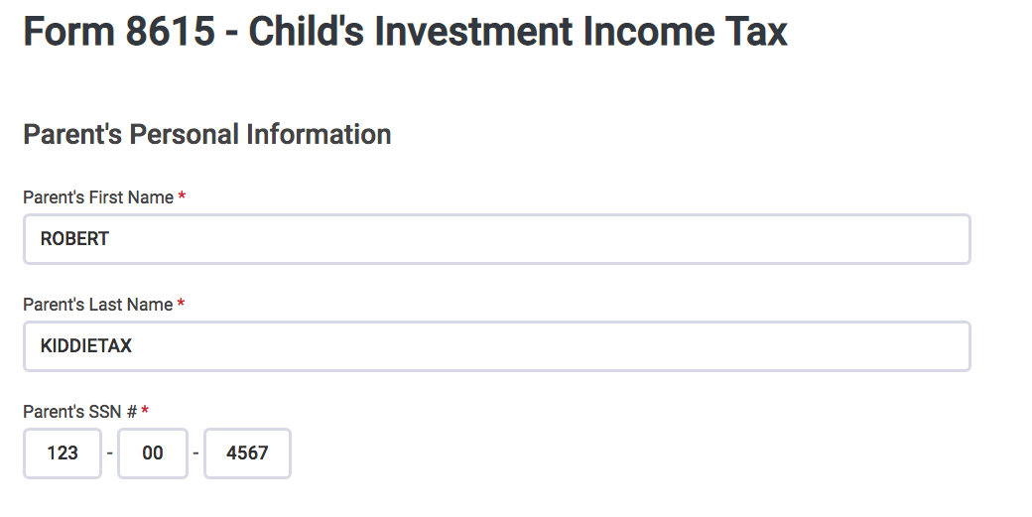
Kiddie Tax – TaxSlayer Entry
Prepare return and enter taxpayer’s (child’s) income as usual
TaxSlayer will identify as earned and unearned correctly
Enter Form 8615 in form selection box -OR- Federal Section > Other Taxes > 8615
Enter Parent’s name and SSN
TaxSlayer calculates Kiddie Tax
Notes:
Enter earned and unearned income into TaxSlayer, select 8615 and enter Parent’s/SSN ... TaxSlayer does the rest

Slide 12
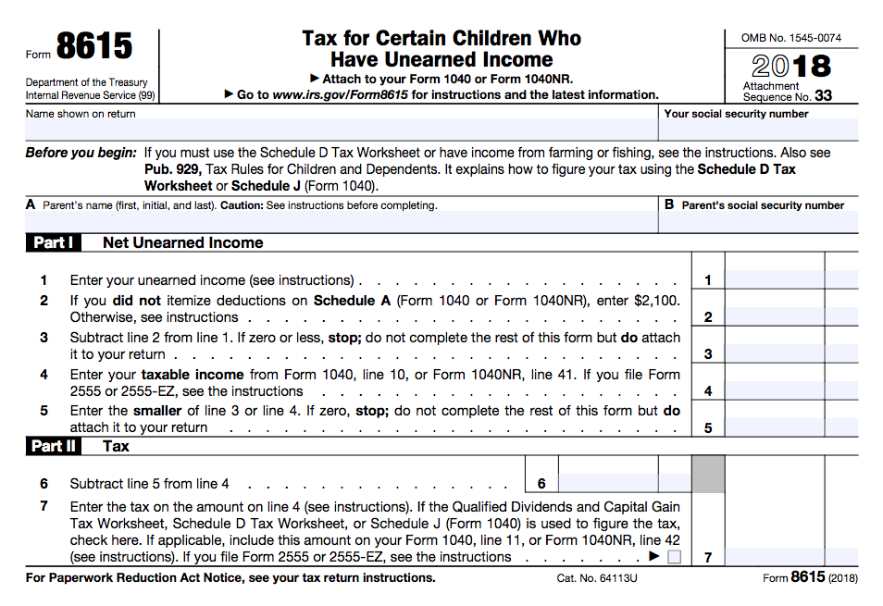
Kiddie Tax – Parent Information
Enter parent’s name and SSN:
Parents married to each other filing MFJ, enter name listed first on tax return
Parents married to each other filing MFS, enter name of parent with higher taxable income
Unmarried, treated as unmarried (HoH), or separated parents, enter name of custodial parent
Unmarried parents living together, enter name of parent with higher taxable income
Notes:
Not sure why form asks for parent’s information. No longer relevant (so long as one is still alive)

Slide 13
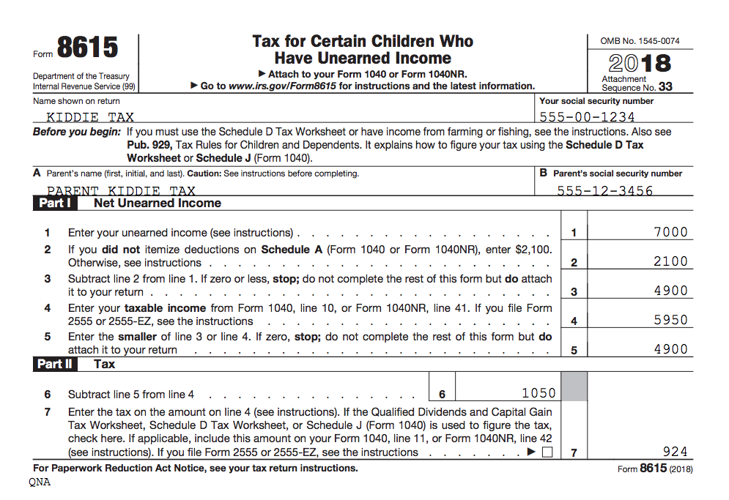
Kiddie Tax Example – Only Unearned Income
Dependent child has $7,000 interest income – no other income
Total tax including Form 8615 = $924
Total tax without Form 8615 = $598
Notes:
TaxSlayer prints the tax calculation worksheet

Slide 14
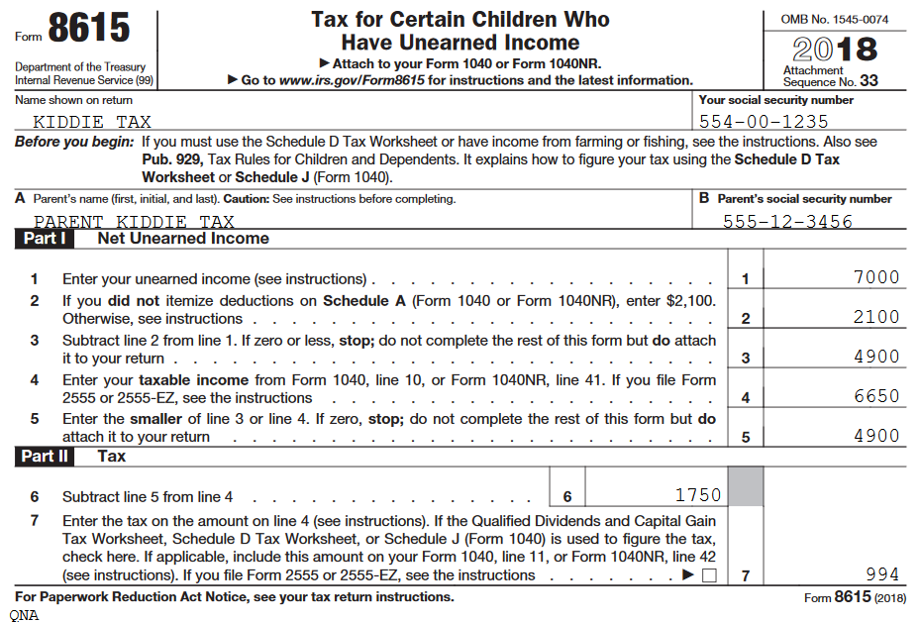
Kiddie Tax Example – Earned and Unearned Income
Same dependent child $7,000 interest income plus $5,000 W-2 income
Total tax including Form 8615 = $994
Total tax without Form 8615 = $668

Slide 15
Other Taxes in Scope
Self-employment tax (Schedule SE)
Social security and Medicare taxes on tip income
Additional taxes on IRAs and other qualified retirement plans Repayment of first-time homebuyer credit
Shared responsibility payment – see ACA lesson
These taxes can be reduced by payments and refundable credits only

Slide 16
Self-employment Tax
Self-employment tax is in addition to income tax
Composed of two elements
Social security
Medicare
Self-employed person pays at 15.3%
TaxSlayer calculates Self-employment tax when data entered on Schedule C
TaxSlayer enters ½ as Self-Employment tax deduction

Slide 17
Self-employment Tax
Applies if net income from self-employment $400 or more
Does not apply to notary public
Does not apply to statutory employee (already withheld on W-2)
Special rules for ministers or church workers – out of scope
Notes:
Because ½ of the SE tax is reduces self-employment income for purposes of the SE tax, Sch C profit of less than $433 will not attract any SE tax

Slide 18
Self-employment Tax
NTTC-modified Pub 4012 Tab H
Notary public
Not subject to self-employment tax by law
NTTC-modified Pub 4012 Tab H Other Taxes and Payments
Enter the notary’s Schedule C profit on Schedule SE in TaxSlayer

Slide 19
Social Security/Medicare Taxes on Tip Income
Tip income included in W-2 Box 7 already had Social Security and Medicare taxes withheld
Allocated tips shown in W-2 Box 8 had no Social Security and Medicare taxes withheld
TaxSlayer automatically calculates additional Social Security and Medicare taxes on Form 4137

Slide 20
Allocated Tip Income
If employee keeps good records
Can enter actual amount of all tips on Form 4137 instead of allocated tip amount
See Income – Wages lesson for TaxSlayer entries
Tip logs available free from IRS

Slide 21
Tips Less than $20 Per Month
Not required to be reported to employer
Presumed included in allocated tips for income tax purposes
Add on W-2 input if not using allocated tip method – “Unreported tips”
Not subject to social security/ Medicare tax
Use Form 4137 Line 5 to remove from tax calculation

Slide 22
Tip Income – Self-Employed
If self-employed, enter tips on Schedule C as cash gross receipts
No separate entry is required

Slide 23
Additional Tax on Early Distributions
Distribution before 59½ not rolled over – “early distribution”
Applies to IRA and employer plan distributions
10% additional tax unless an exception applies
25% for SIMPLE IRAs

Slide 24
Early Distribution Additional Tax
Pub 4012 Tab H
Find Other Taxes and Payments (continued) in Pub 4012 Tab H – Form 5329 TaxSlayer input
Some exception codes apply to IRAs
Some exception codes apply to other types of plans
Some exception codes apply to both

Slide 25
Highlight Certain Exception Codes
Pub 4012 Tab H
05 The amount paid for medical expenses, minus 7.5% of AGI
Same amount as would show on Sch A
No tracing of funds needed – simply have medical expenses
09 Used to buy or build first main home
Must be used within 120 days of distribution
12 More than one exception code or other reason
See footnote 2 to exceptions list in Pub 4012 Tab H
Use also for distributions incorrectly coded on Form 1099-R

Slide 26
Highlight Certain Exception Codes
Pub 970
08 The amount of higher education expenses* includes:
For self, spouse, foster child, adopted child or grandchild
Does not have to be a dependent
Tuition, fees, books, supplies and equipment required to enroll or attend
Special needs services expenses for special needs student
*See Pub 970 Chapter 9 for more detail

Slide 27
Highlight Certain Exception Codes
08 Education (cont.)
Room and board if student is at least half-time
Can be at-home room and board
Based on allowance established by education institution
Reduced for nontaxable scholarships, grants or ESA distributions (but not Qualified Tuition Program distributions)
No tracing of funds is required – exception can be used if education expenses were paid
Expenses can be used for the exception and as an education benefit
Notes:
Room and board amount may be limited – refer to Pub 970, Ch 9.

Slide 28
Early Distribution Quiz
Joyce, age 50, has no medical insurance
She took a $10K distribution from her traditional IRA in June 2017 when she broke her arm
Her total unreimbursed medical expenses for the year were $8K
Her AGI is $50K
Q: What, if any, is the additional tax due on this distribution?

Slide 29
Early Distribution Quiz Answer: $575
Line | Form 5239 Part I Entry
1 | $10,000 [Early distribution included in income]
2 | Code 05 and $4,250 [Amount of early distribution not subject to additional tax] which is the $8,000 of medical expenses less 7.5% of her $50K AGI or $8,000 minus $3,750 = $4,250
3 | $5,750 [Amount subject to additional tax] which is $10,000 minus $4,250 from Line 2
4 | $575 [Additional tax = 10% of Line 3]

Slide 30
Missed RMD from Traditional IRA
Required Minimum Distribution (RMD) not taken after age 70½
IRA trustee normally calculates RMD but always taxpayer’s responsibility
RMD applies to total traditional IRAs – not Roth IRAs
Inherited IRAs have different rules – Pub 590-B
Can request a waiver of the 50% additional tax – in scope for Tax-Aide – but not for VITA
Notes:
Taxpayer can withdraw the RMD from any IRA so long as the total RMD is withdrawn

Slide 31
Missed RMD
NTTC-modified Pub 4012 Tab H
Find Failure to take required minimum distribution in NTTC-modified Pub 4012 Tab H
Taxpayer must remedy the distribution shortfall by taking an additional distribution
Will result in more than one year’s distribution in the year of remedy
Then request waiver

Slide 32
Missed RMD
Possible explanations (examples):
Clerical or math error
Relied on Trustee who failed to make the RMD
Taxpayer impaired by health
Beneficiary not notified by trustee that RMD not taken
IRS accepts most reasonable explanations
Notes:
Math or clerical error

Slide 33
Missed RMD
Counselor not expected to verify that required distributions were taken
Ask taxpayers if they have an IRA
Ask taxpayers if they withdrew RMD
Remind taxpayers approaching age 70 of RMD requirement and to check with trustee

Slide 34
Additional Tax on IRAs, etc.
Other parts of Form 5329 out of scope:
Part II: 10% tax on education and ABLE accounts
Parts III – VIII: 6% tax on excess contributions to various qualified accounts not removed by due date of return

Slide 35
First Time Homebuyers Credit Payback
Did taxpayer receive First Time Homebuyers Credit (FTHC) in 2008?
Review 2017 return for repayment

Slide 36
First Time Homebuyers Credit Payback
FTHC claimed in 2008
Repayment started in 2010
Payments continue until full amount of credit repaid – usually $500 per year but can repay more
Form 5405 may not print – not needed for annual payback
May need to repay balance in some situations
Taxpayer can look up amount of credit still owed on irs.gov > First Time Homebuyer Credit Account Look up
Notes:
The original amount was $7,500 repayable $500 per year
Repayments can continue through 2024

Slide 37
Home Ceases to be Main Home
If disposed of home purchased in 2008 or home ceased to be main home, must generally repay balance of un-repaid credit with current tax return
Exceptions apply
Complete Part I of Form 5405 and see instructions for Form 5405 for additional repayment information

Slide 38
Home Ceases to be Main Home
Certain cessation events are out of scope
Conversion to rental property
Condemnation
Foreclosure
If taxpayer and spouse claimed credit on joint return in 2008
Each files a separate Form 5405 showing their share when form required

Slide 39
Exceptions to Full Repayment
If home sold to someone not related to taxpayer, repayment limited to gain on sale – Part III of Form 5405
If home destroyed or sold through condemnation, and if new main home purchased within two years of event, can continue with annual payments – out of scope

Slide 40
Exceptions to Full Repayment
If taxpayer or spouse dies before full repayment
The decedent’s share of the credit does not have to be repaid

Slide 41
Quality Review
Review special situations for self-employment tax
Notary or statutory employee
Verify tax on tip income Form 4137 correct
Review exceptions for early distributions

Slide 42
Quality Review
Request a waiver if RMD missed
Confirm First Time Homebuyers Credit repayment
Review return for kiddie tax consequences

Slide 43
Other Taxes
Questions?
Comments?
Notes:
43

